Slide 1
Eli

Slide 2
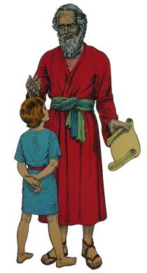
1 Samuel 3:11-14
Then the LORD said to Samuel: “Behold, I will do something in Israel at which both ears of everyone who hears it will tingle. In that day I will perform against Eli all that I have spoken concerning his house, from beginning to end. For I have told him that I will judge his house forever for the iniquity which he knows, because his sons made themselves vile, and he did not restrain them. And therefore I have sworn to the house of Eli that the iniquity of Eli’s house shall not be atoned for by sacrifice or offering forever.”

Slide 3
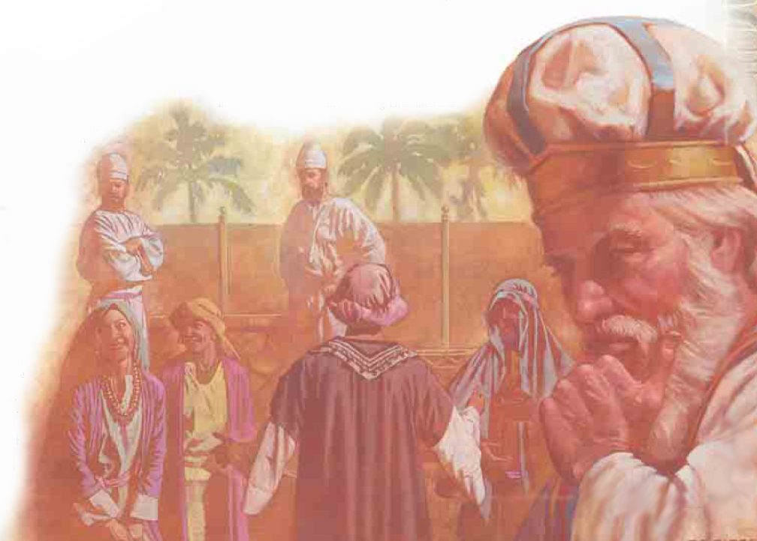
1 Samuel 2:22-25

Slide 4
Failure to Restrain His Sons
1 Samuel 2:29
Deuteronomy 21:18-21
Eli was Too Soft, Too Easy Toward His Children

Slide 5
Pious Softness Is Not The Way of God
John 2:13-17
Matthew Chapters 15 and 23
Pious Softness Fails In The Home
Ephesians 6:4
Deuteronomy 6:7; 32:45
Proverbs 3:12; 13:24; 29:15-17

Slide 6
Pious Softness Fails in Society
Government Supposed to Punish Evil-doers –
1 Peter 2:13-14
Includes Carrying Out Death Penalty – Romans 13:3-4; Genesis 9:6; Ecclesiastes 8:11

Slide 7
Pious Softness Fails in The Church
1 Corinthians 5:1-5, 11-13
Ephesians 5:11
2 Thessalonians 3:6, 14-15
Ecclesiastes 8:11
Romans 16:17; 1 Timothy 6:3-5
Titus 3:10-11

Slide 8
God Remains The Same
Hebrews 13:8
Matthew 24:35
John 14:27
Philippians 4:6-7
John 14:6

Slide 9
Softness Leads to Compromise and Compromise Results in Apostasy!

